Slide 1
Thailand’s HIV and AIDS STRATEGY 2012-2016
LEADING THE WAY:
Petchri Sirinirund
National AIDS Management Center

Slide 2
Presentation Guide
Background: HIV in Thailand & rationale for inclusion of S&D in National Strategy
Process of how it came about
National AIDS Strategy 2012-2016
  National Strategic Information and Monitoring and Evaluation Plan 2012-2016
  National Biannual Operational Plan

Slide 3
Projected New HIV Infections by Mode of Transmission (using Asian Epidemic Model)
Total population : 64 million (2011)
6%
Casual and extramarital sex
Spousal transmission
32%
41%
10%
Injecting Drugs
11%
Sex workers and clients
62% of
new infections
41%
Men who have sex with men
43,040 new infections

Slide 4
CD4 Level at the time of diagnosis and ART initiation
ART coverage 2011: 77%
Yr
N
6,163
8,243
8,601
8,326
13,972
13,575
13,237
13,738
<100 cells/mm³
100-200 cells/mm³
201-350 cells/mm³
>350 cells/mm³
Source of data: NAP database, National Health Security Office

Slide 5
Process for Inclusion of S&D in National Strategy
Participatory process from government and civil society sectors
Evidence
  Annual report of the situation of AIDS rights by Foundation for AIDS Rights
  Study on stigma index
Civil society’s agenda for HIV and AIDS
Extensively consultation process on human rights issues

Slide 6

รูป AIDS ZERO
Thailand National AIDS Strategy
2012-2016

Slide 7
Vision and Goals
Vision: To get to Zero New HIV Infections
Goal for 2016:
New HIV infections reduced by two-thirds
Rate of vertical transmission of HIV less than 2%
Vision: To get to Zero AIDS-related Deaths
Goal for 2016:
Equal access to quality treatment, care, support and social protection for all people affected by HIV
AIDS related deaths reduced by half
TB deaths among people living with HIV reduced by half
Vision: To get to Zero Stigma and Discrimination
Goal for 2016:
All laws and policies which obstruct equal access to prevention, treatment and care services are revised
Human Rights and gender specific needs are addressed in all HIV responses
Stigma and discrimination of PLHIV and key affected populations reduced by half

Slide 8

Access to prevention
Access to treatment
Zero
stigma and discrimination
Adequate resources
Treatment as Prevention
Zero new infections
Zero AIDS related deaths

Slide 9

2 Strategic Directions
A. Innovation and Change
1. Expand rights based and gender sensitive comprehensive prevention services for populations with risk behavior with highest number of HIV infections
2. Expand the protective social and legal environment essential for HIV prevention and care
3. Create sense of ownership at the local level in the expansion of prevention and control of AIDS
4. Implement a new generation of strategic information to inform and guide the national response at all levels
B. Optimization and Consolidation
5. Harmonize and optimize interventions and programs focusing on:
  Prevention of Mother to Child Transmission (PMTCT)
  Prevention among Young People
  Condom Programming
  Blood Safety and Universal Precaution
  Treatment, Care and Support
  Care and Support for Children Affected by AIDS
  Stigma and Discrimination
  Public Communication

Slide 10
National Operational Plan 2013-2016
Review and change law, regulations, policies hindering access to services
Promote the implementation of enabling policies
Establish human rights protection mechanism at provincial level
Campaign for understanding on sexuality rights, AIDS rights and human rights
Promote the right based health and counseling services
Empower PLHIV and KAPs

Slide 11
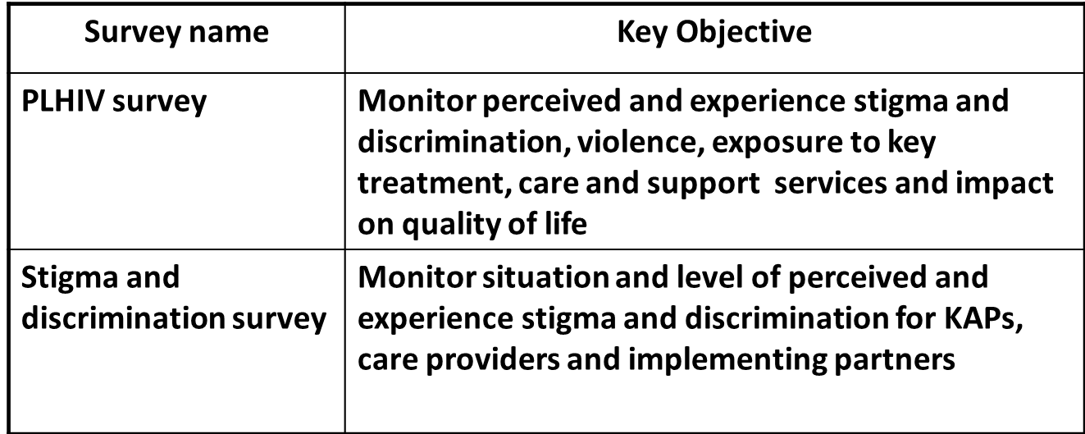
New Routine Integrated HIV Information System
Crisis response monitoring system
  Unified system to monitor violence, crisis related to rights, laws, stigma and discrimination from provincial to national level
Establish new surveys to monitor HIV response

Slide 12

รูป AIDS ZERO

